Slide 1
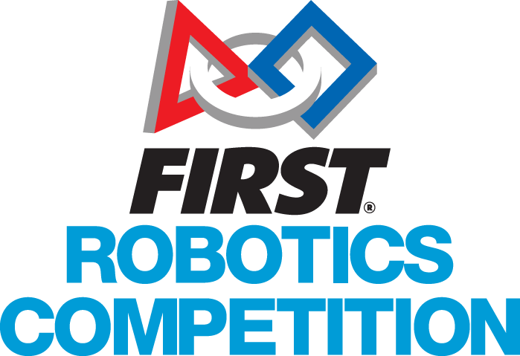
What is FIRST?
For Inspiration and Recognition of Science and Technology
Cascade/Everett High School
Otter Chaos 4512 Robotics Team

Slide 2
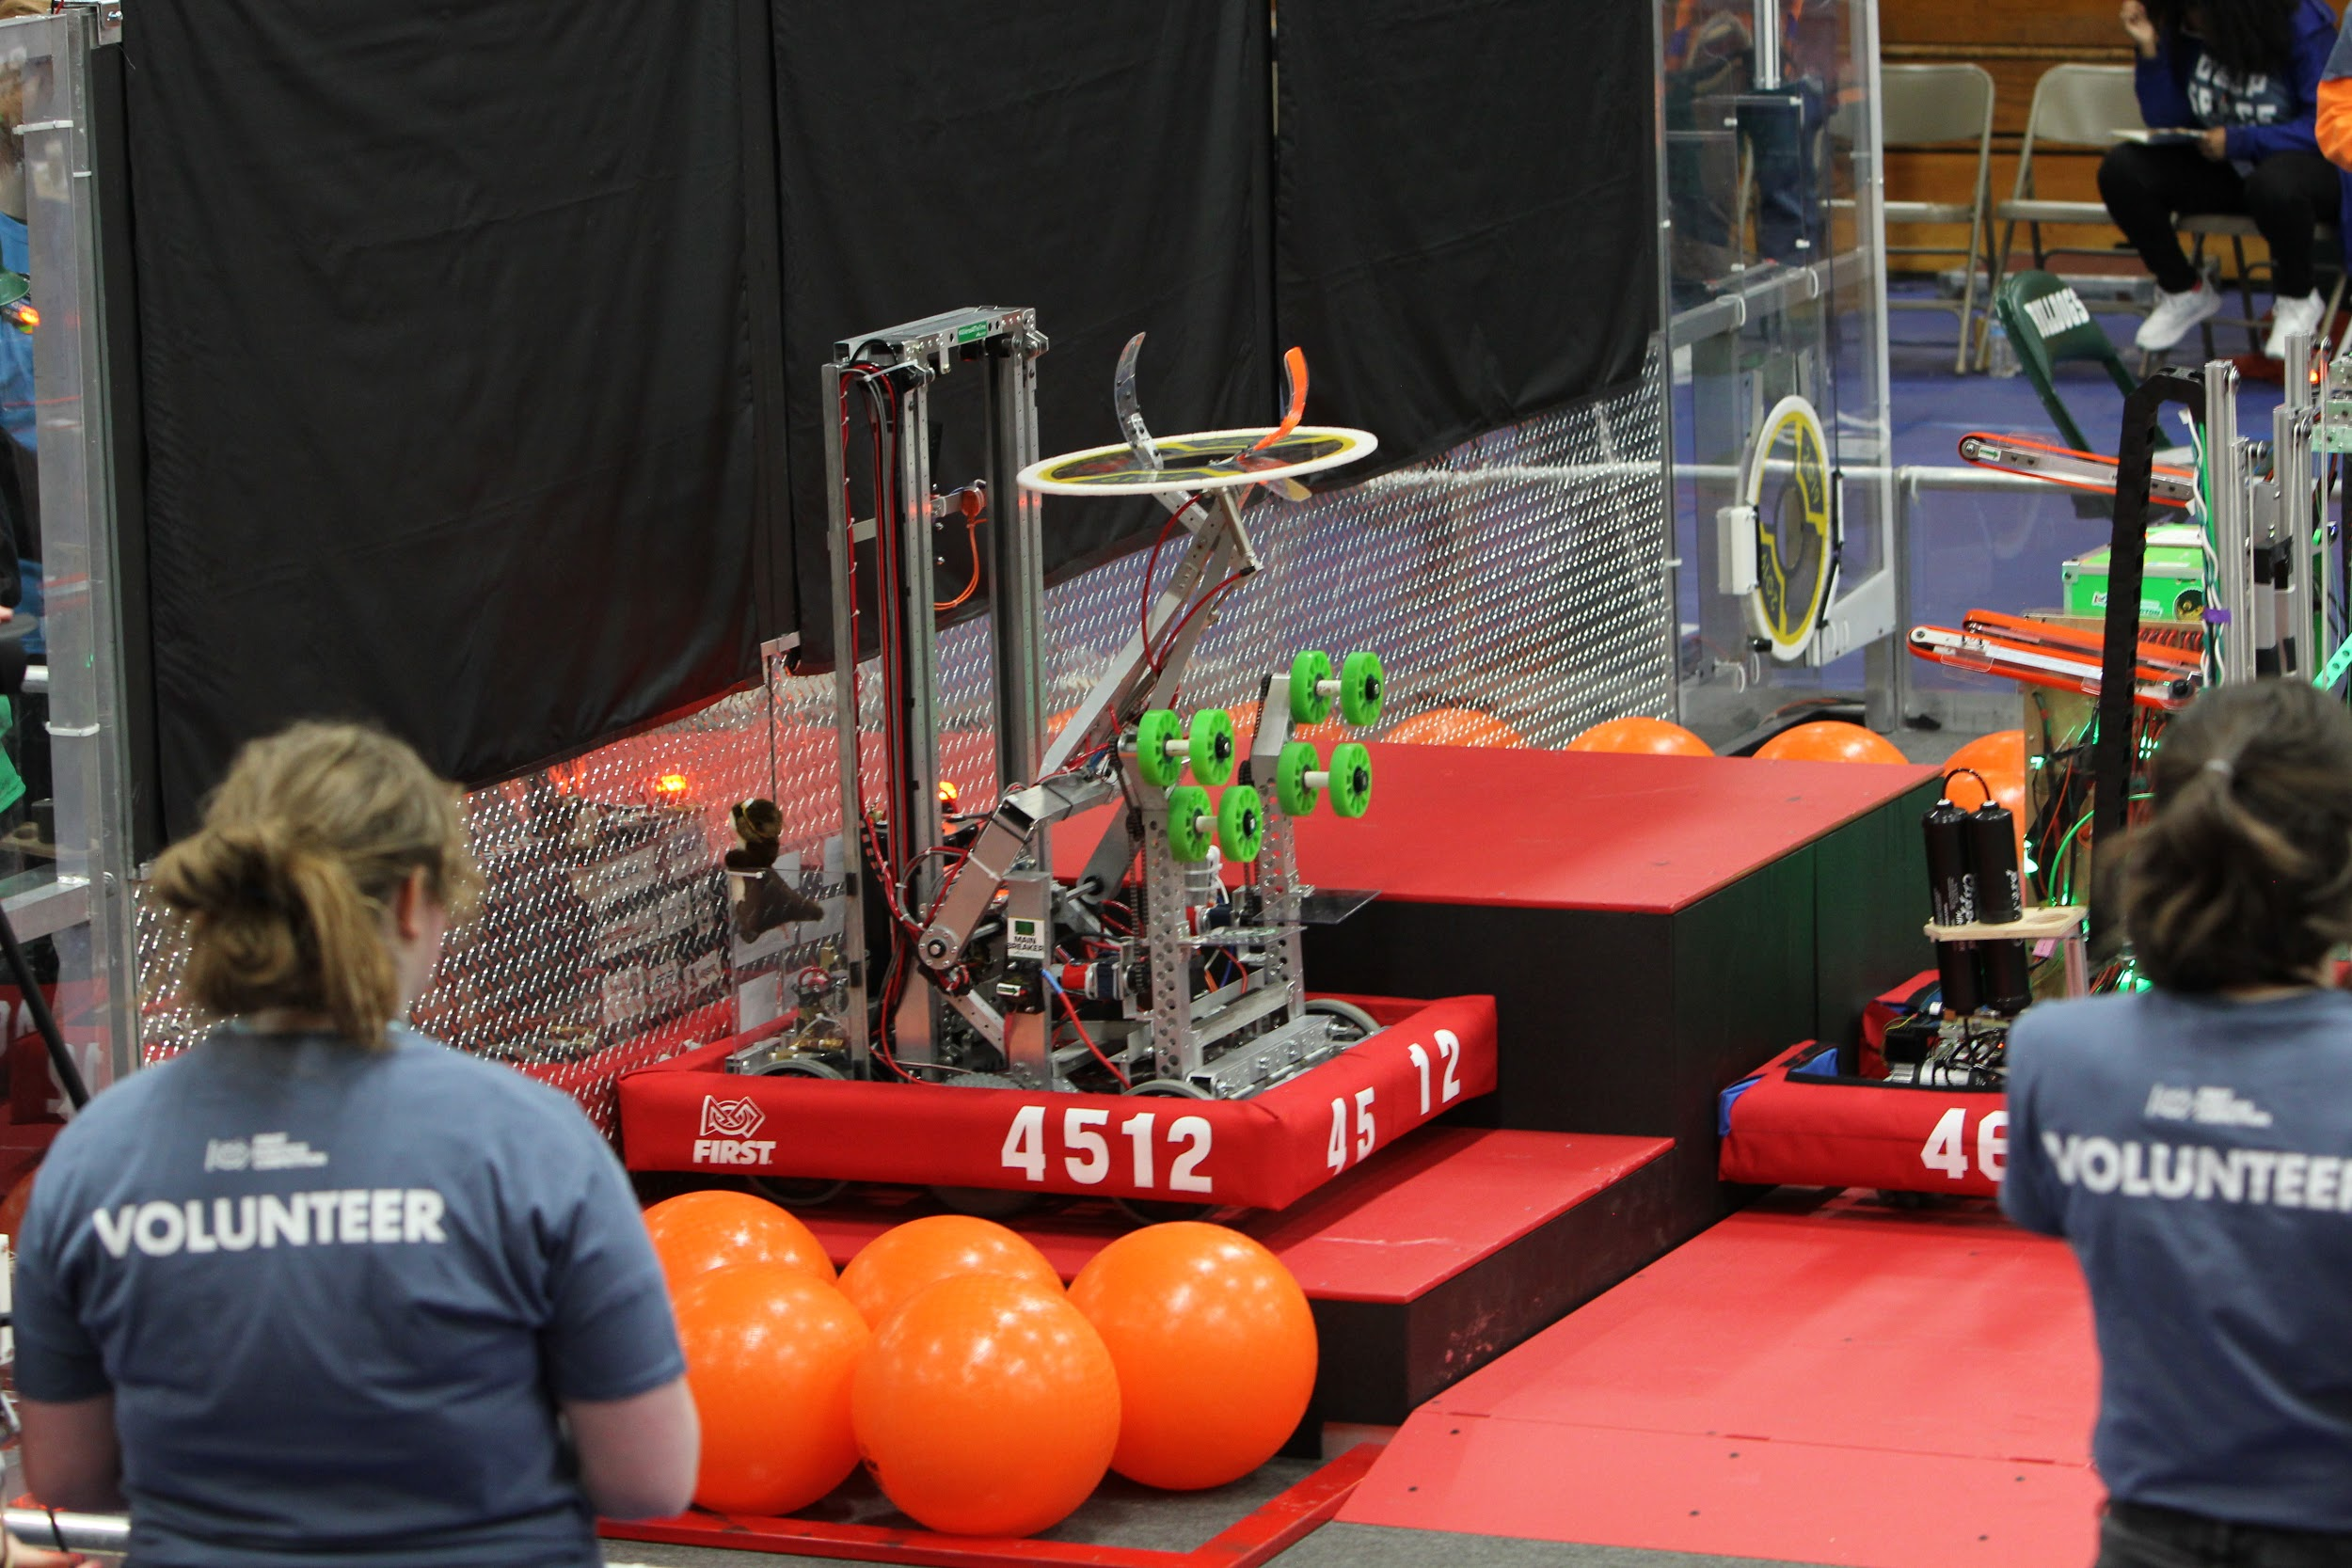
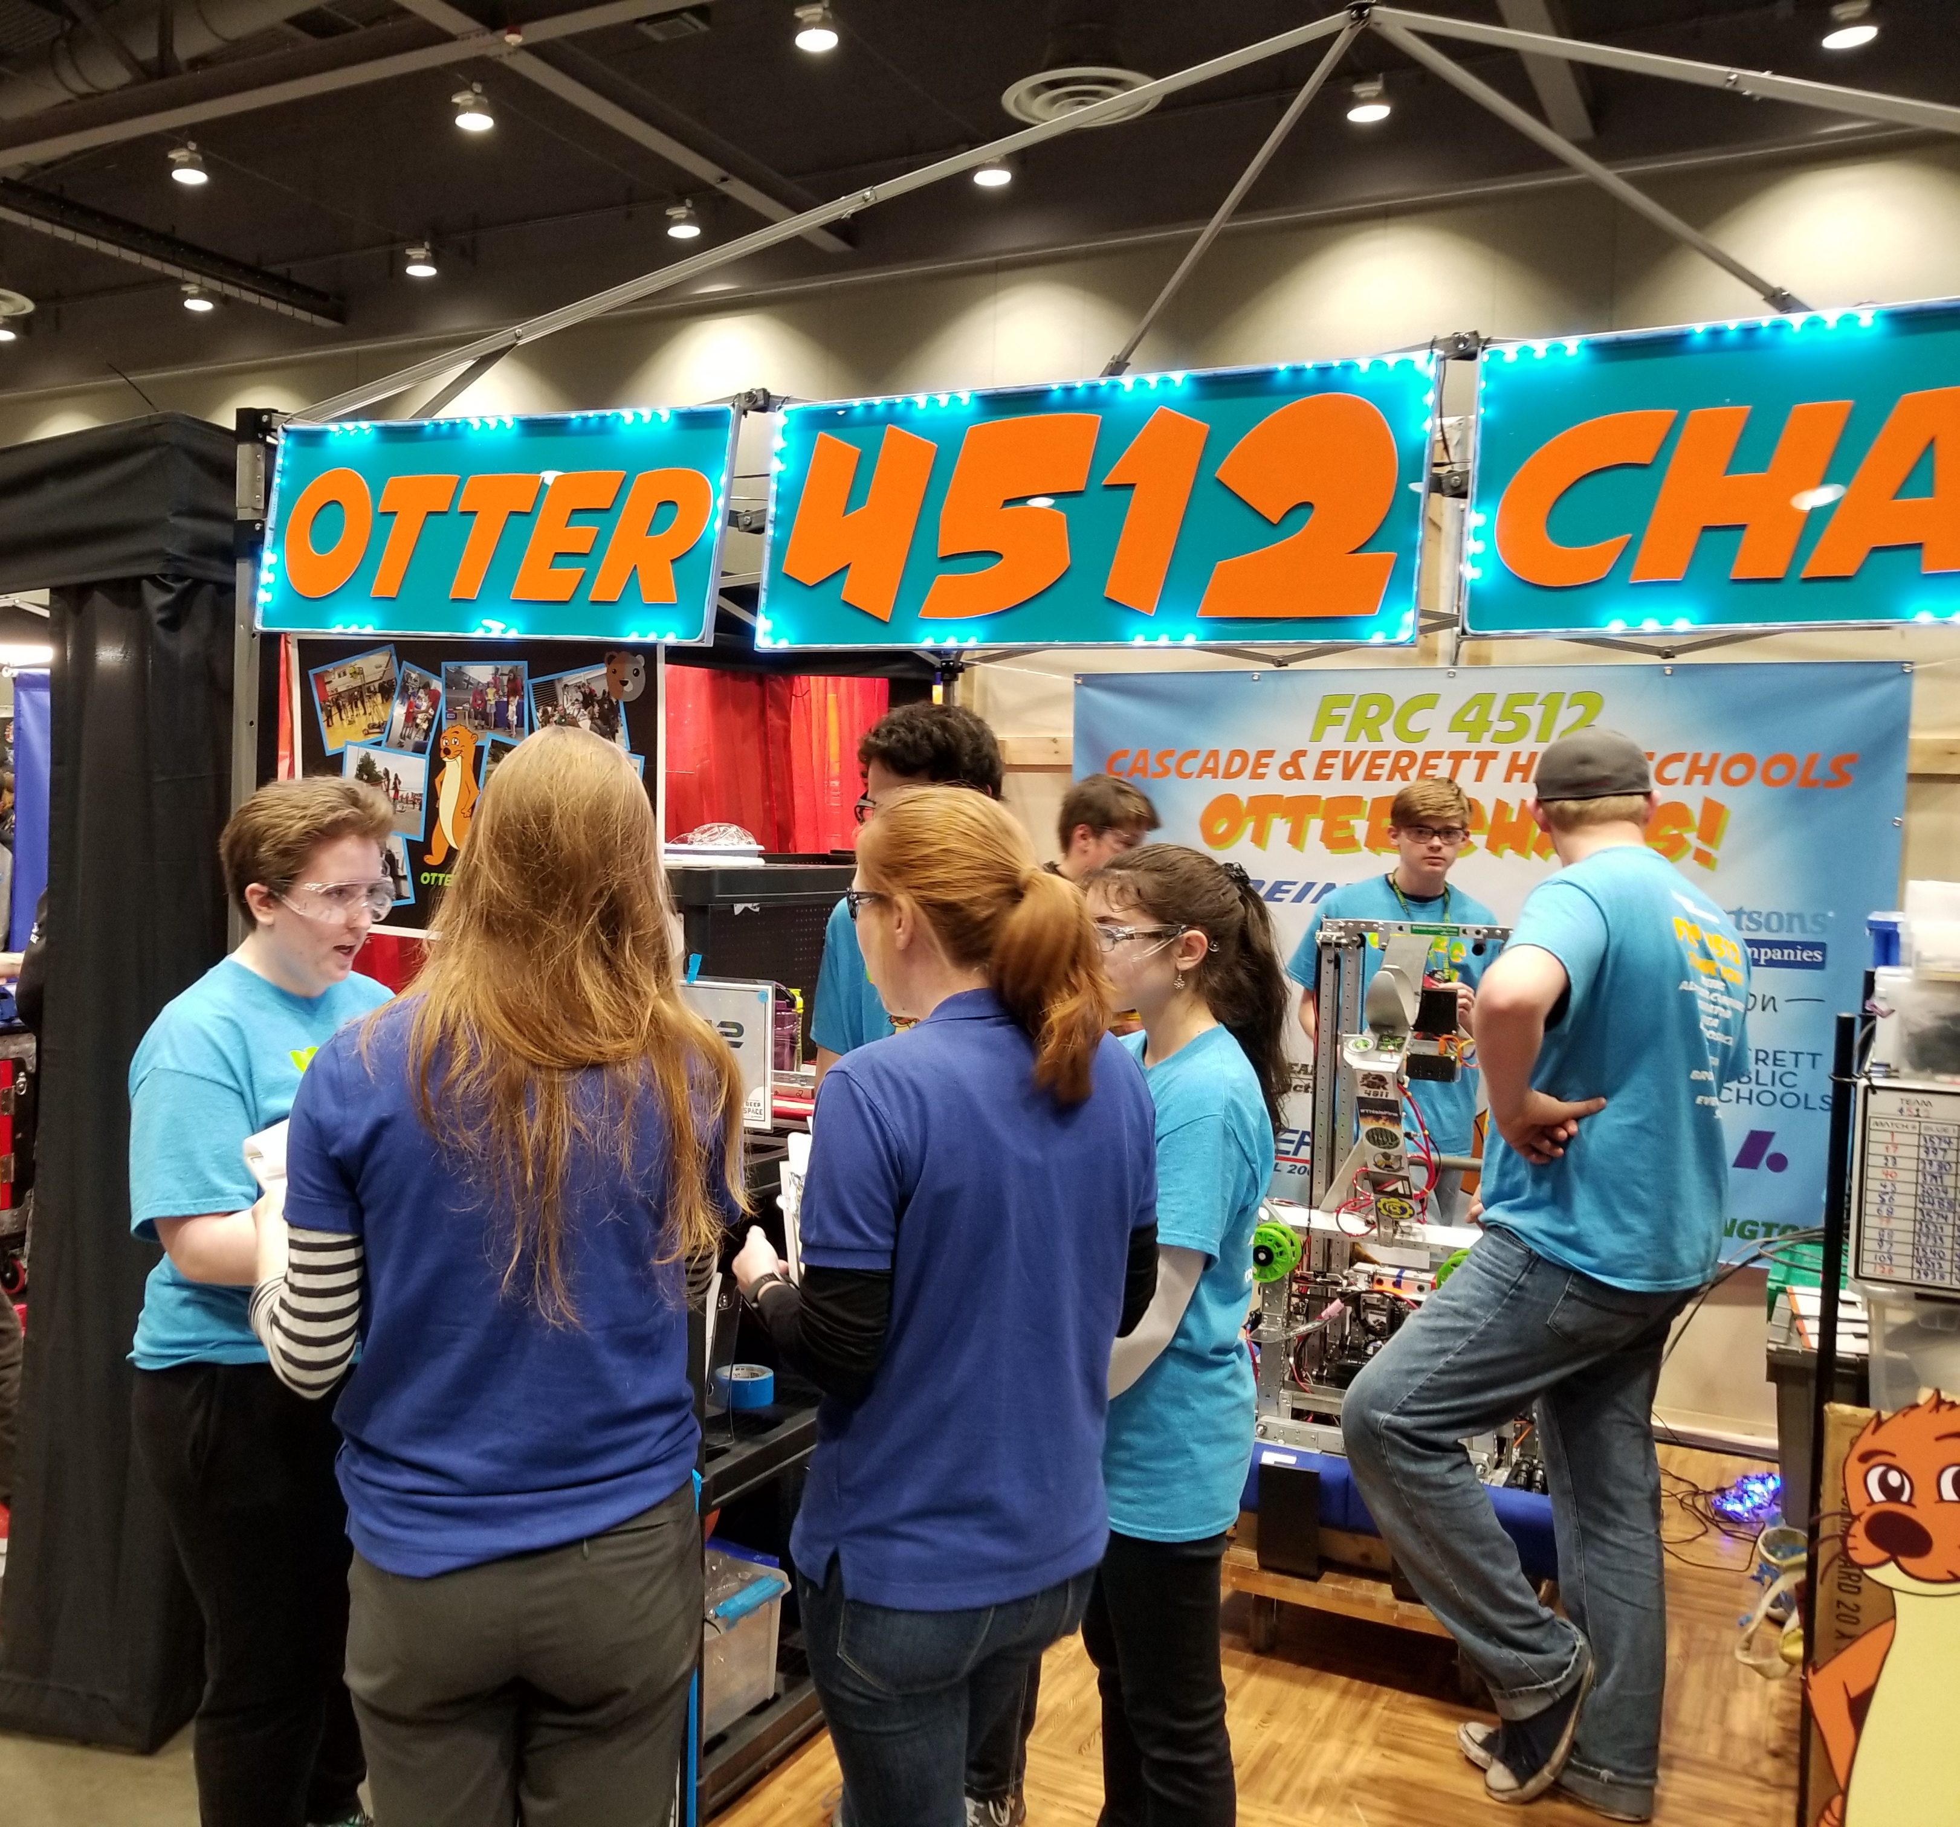
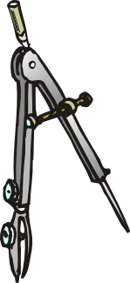

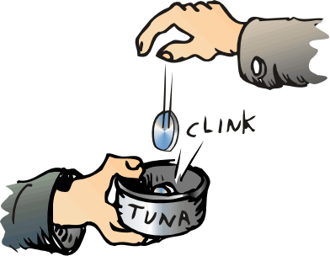
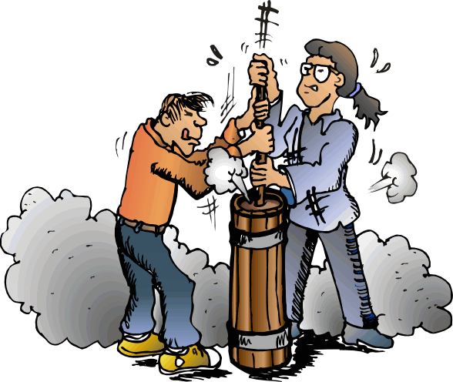

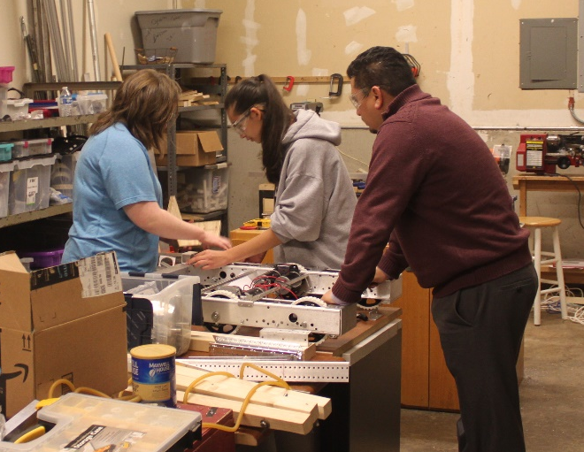
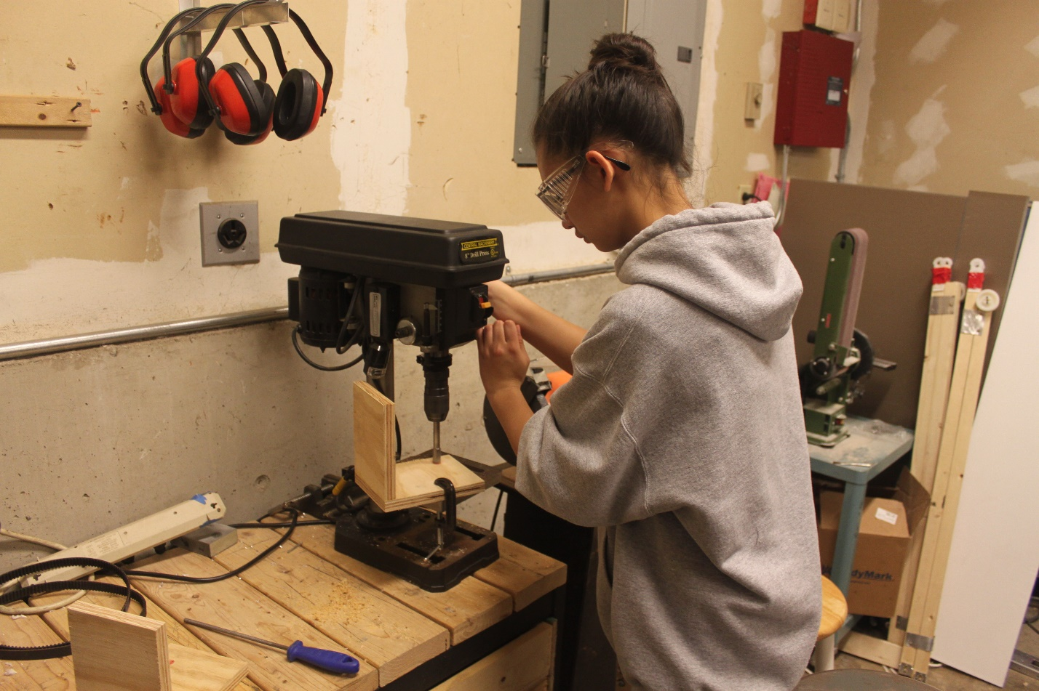

What IS FIRST?
Learning opportunities and community
Mechanical
Electrical
Programming
Business and Marketing
Fundraising
Competition
Notes:
FIRST is a learning opportunity for students where they can participate in activities to design and build a robot on a team in 6 weeks before you compete against other teams from the state and beyond.
It is a learning opportunity where students can learn a variety of things such as mechanical, electrical and programming. Although there are engineering activities, there are also non-engineering things that you can do such as learning how to run a business and marketing.

Slide 3
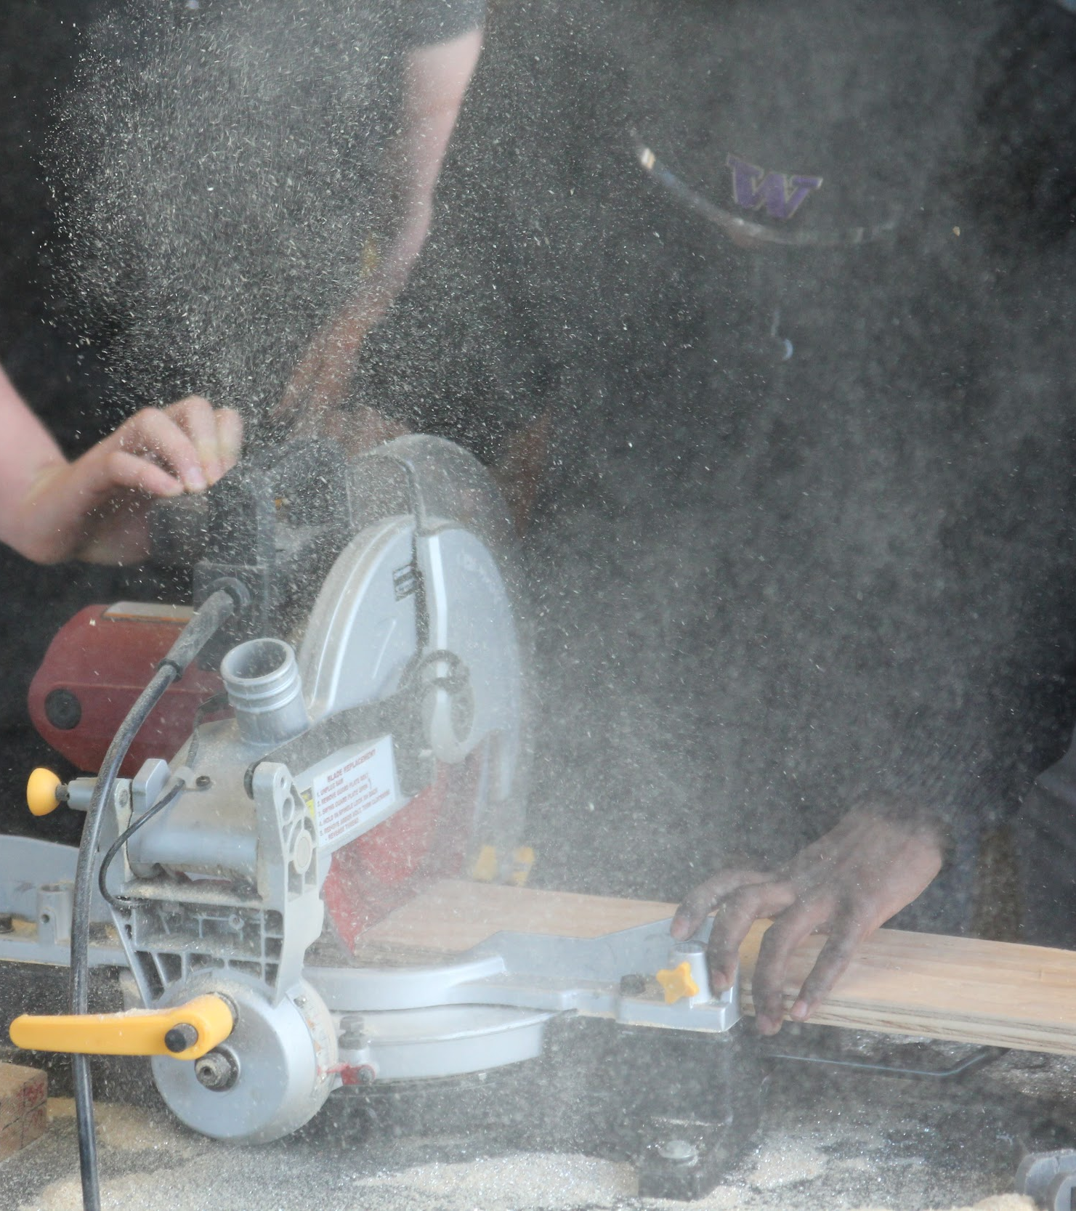
How Does Robotics Introduce Engineering?
Mechanical
  Designing and building robot
  Using power tools
Electrical
  Cable management
  Soldering
Programming
  Learning Java
  Creating intuitive control methods
Notes:
The engineering side of robotics is made up of mechanical, where you can learn about CAD(Computer Assisted Design) for the robot’s parts, building the robot, and using power tools like drills, a drill press, a bandsaw, etc. Electrical which has cable management for the robot to make it organized and easy to access if anything goes wrong and soldering. Lastly there is programming where you learn about Java and create the code that the robot will use to be able to move around and operate its parts.

Slide 4
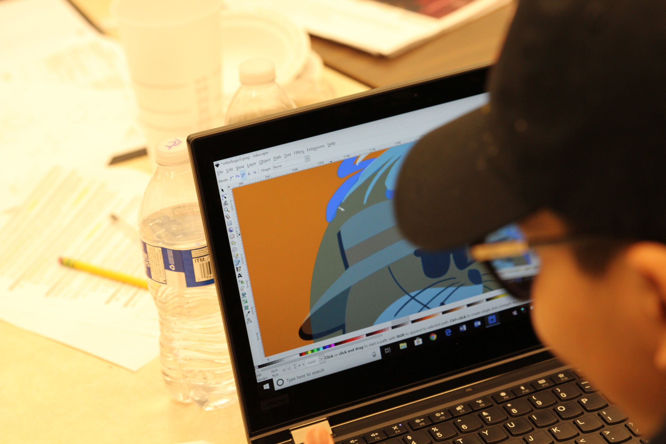
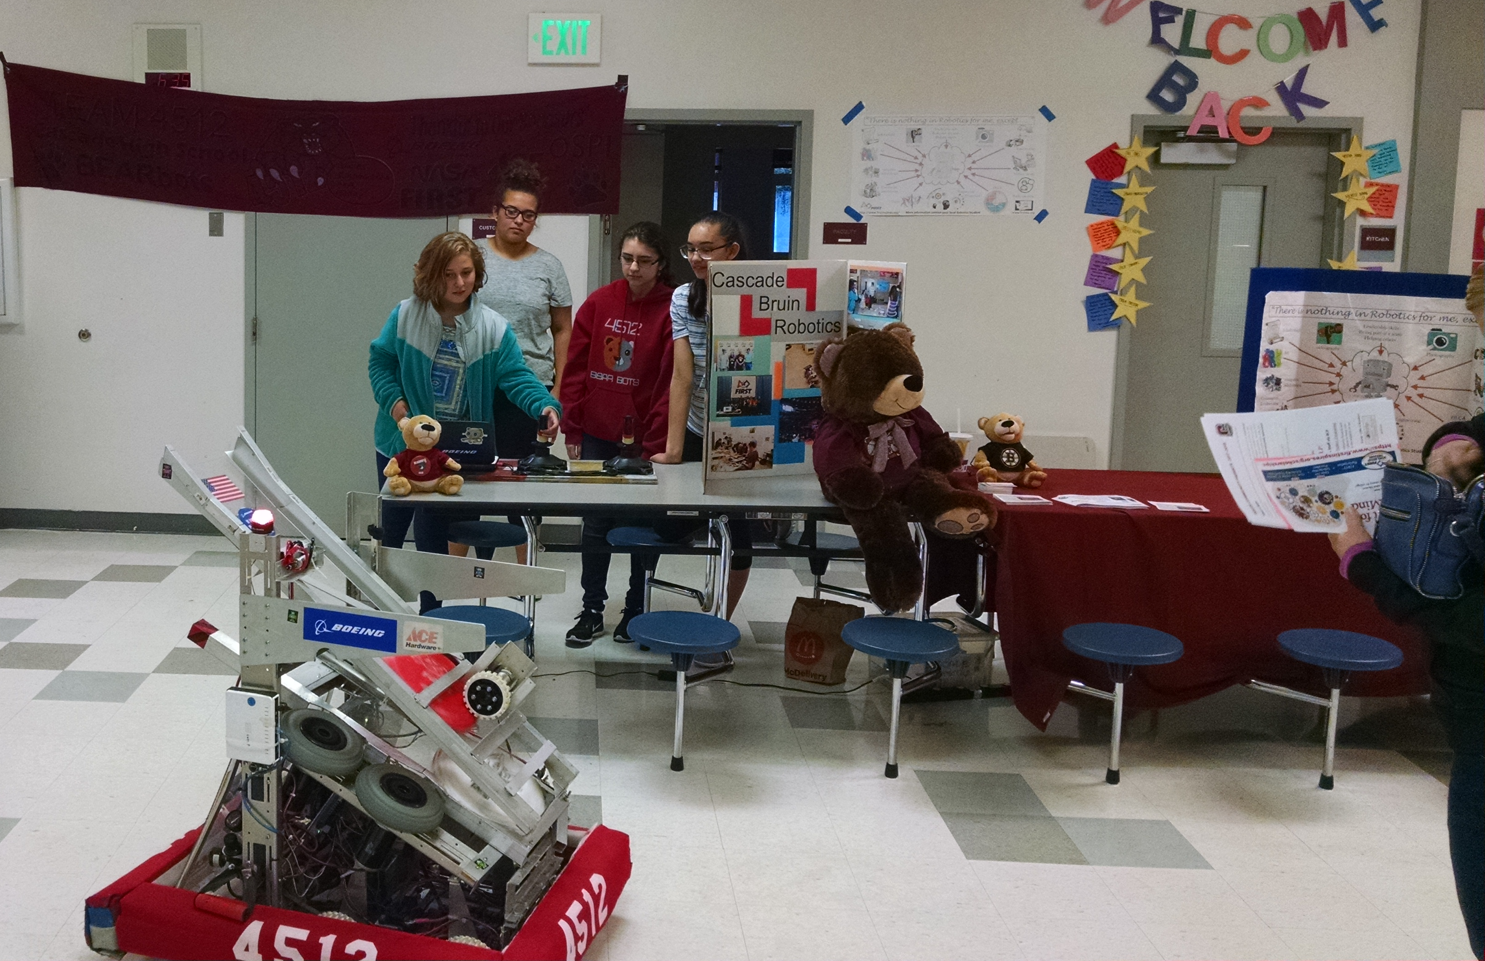
The Non-Engineering Part of Robotics
Business
  Finances, management, sponsorships, etc.
Media
  Photography
  Cinematography
  Web design
Branding
  Logo, shirts, buttons, etc.
Community Outreach
  Connecting with our school
Team Bonding
Notes:
There is also the non engineering side of robotics is filled with the business, media, branding, community outreaches, and team bonding. Business is where you manage the team’s finances and sponsorships. You basically cause the team to not spend money on un

Slide 5
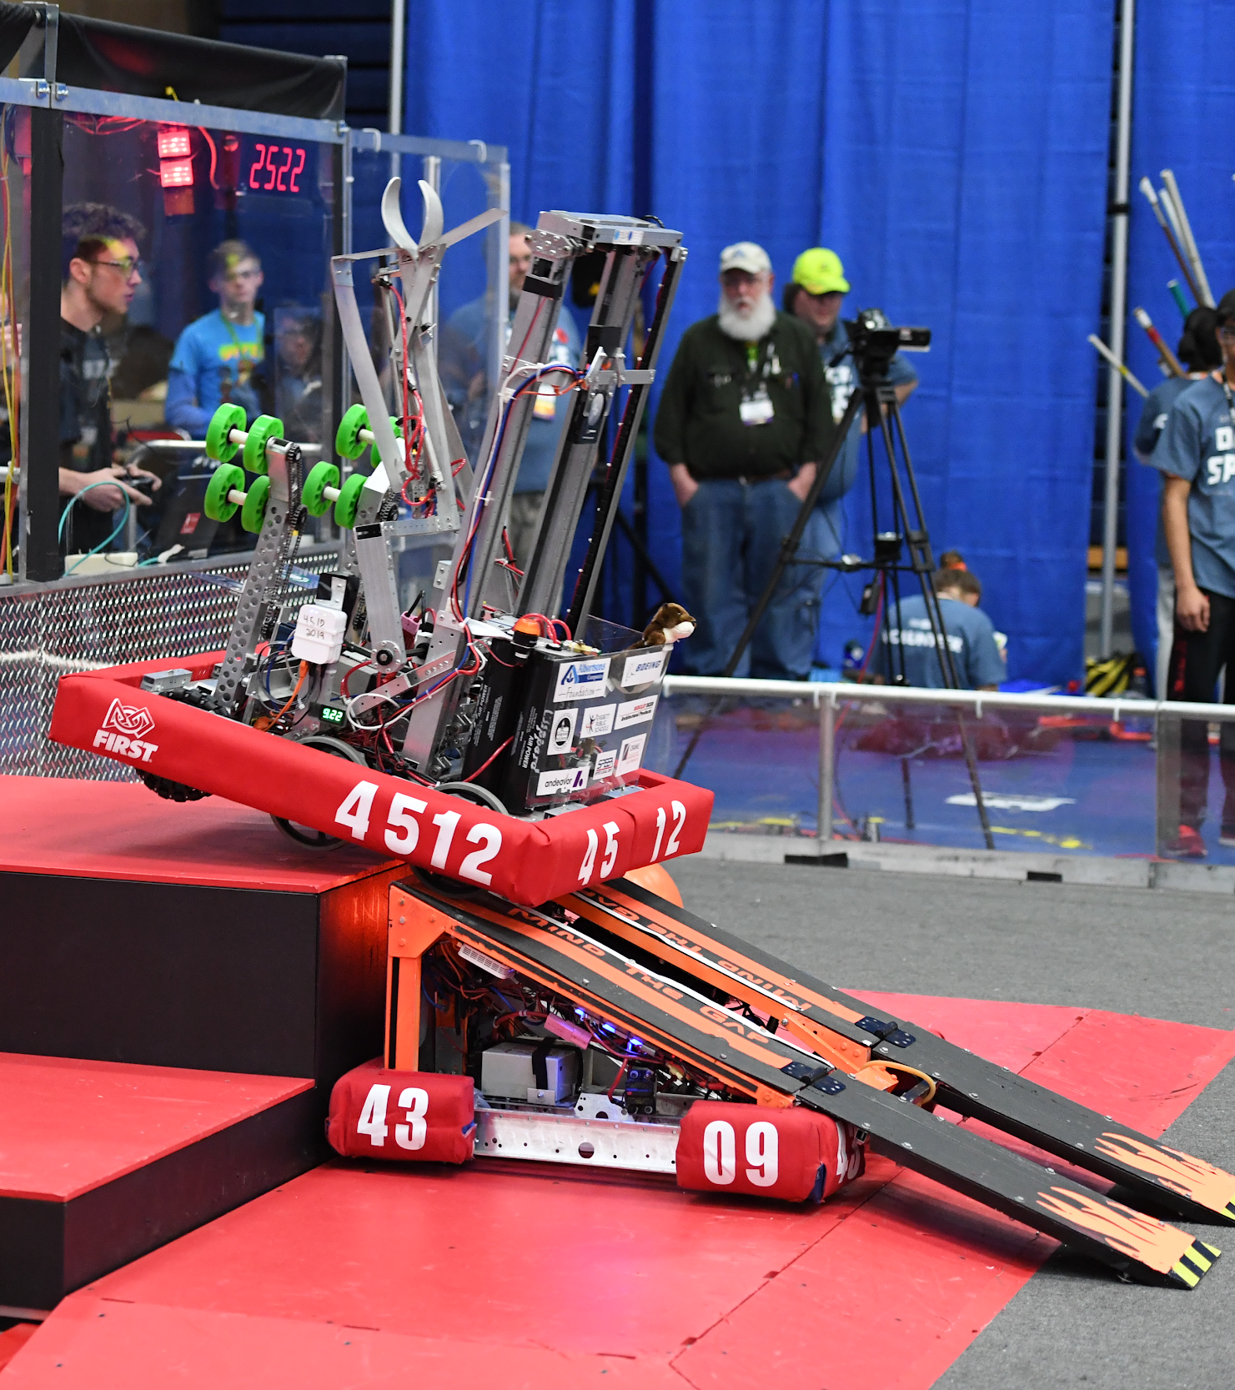
Competition
Scouting
Drive Team
Team Spirit
Fun
Buttons

Slide 6
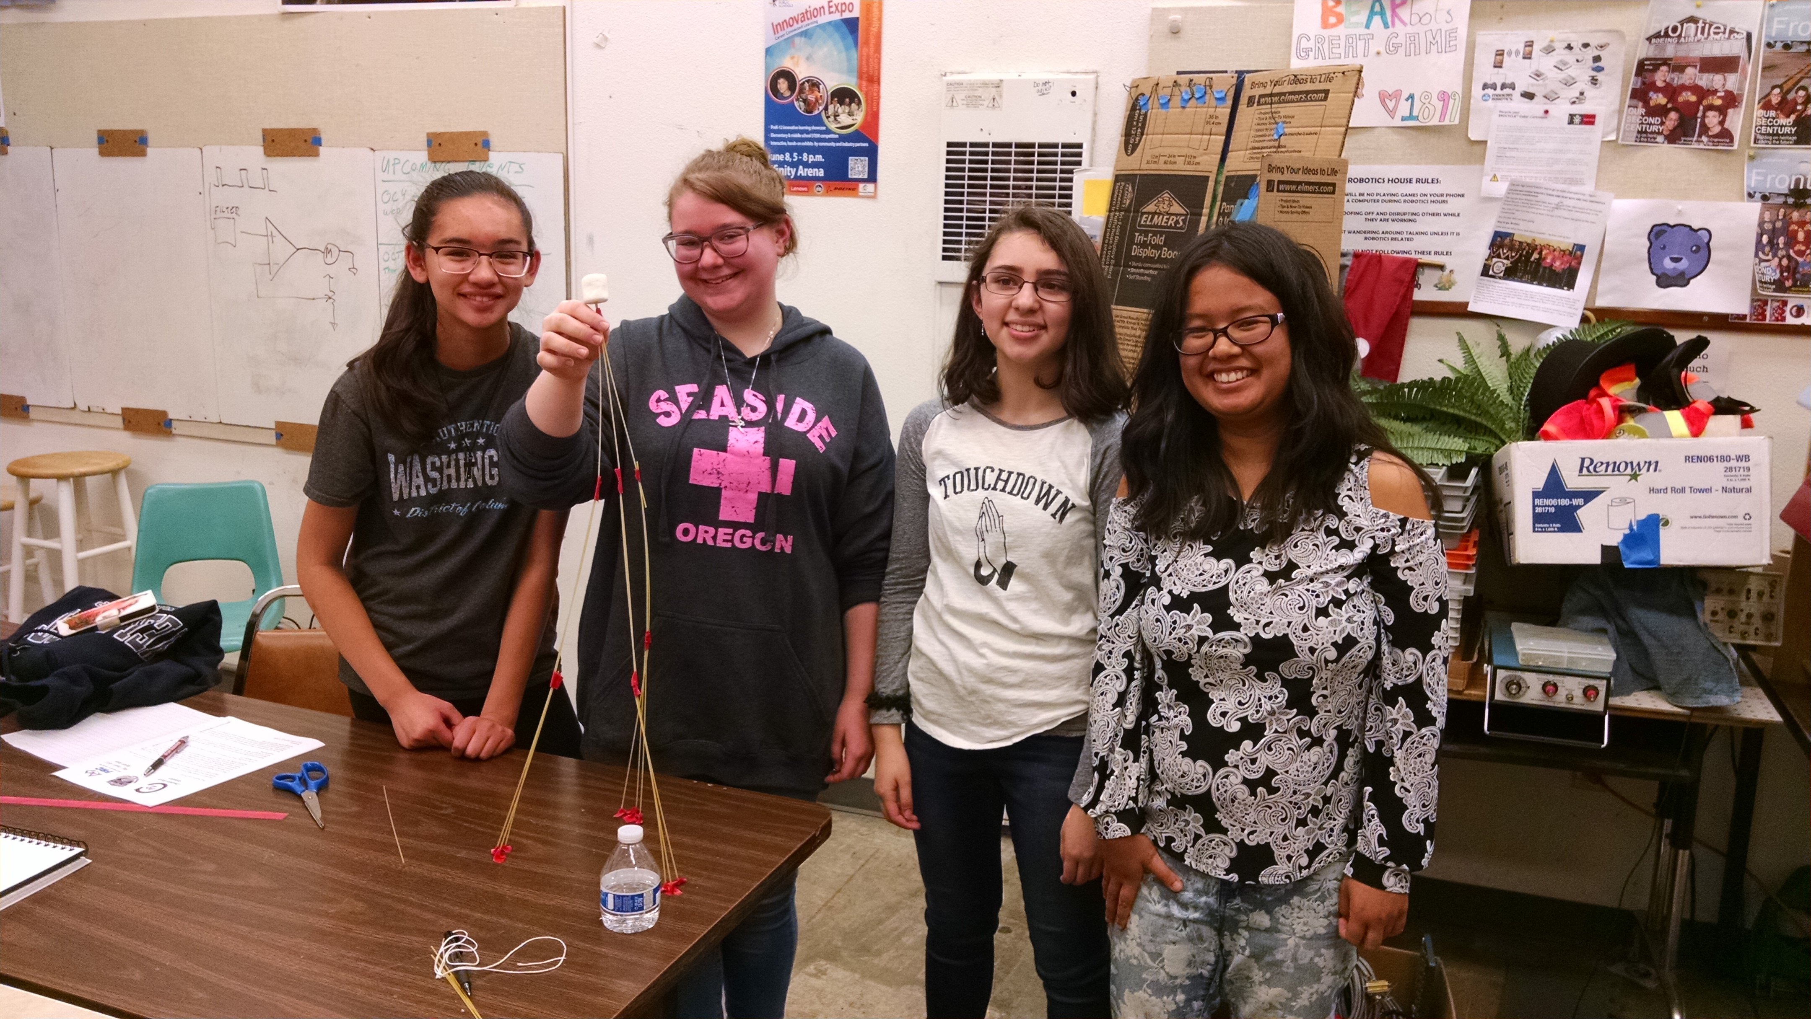
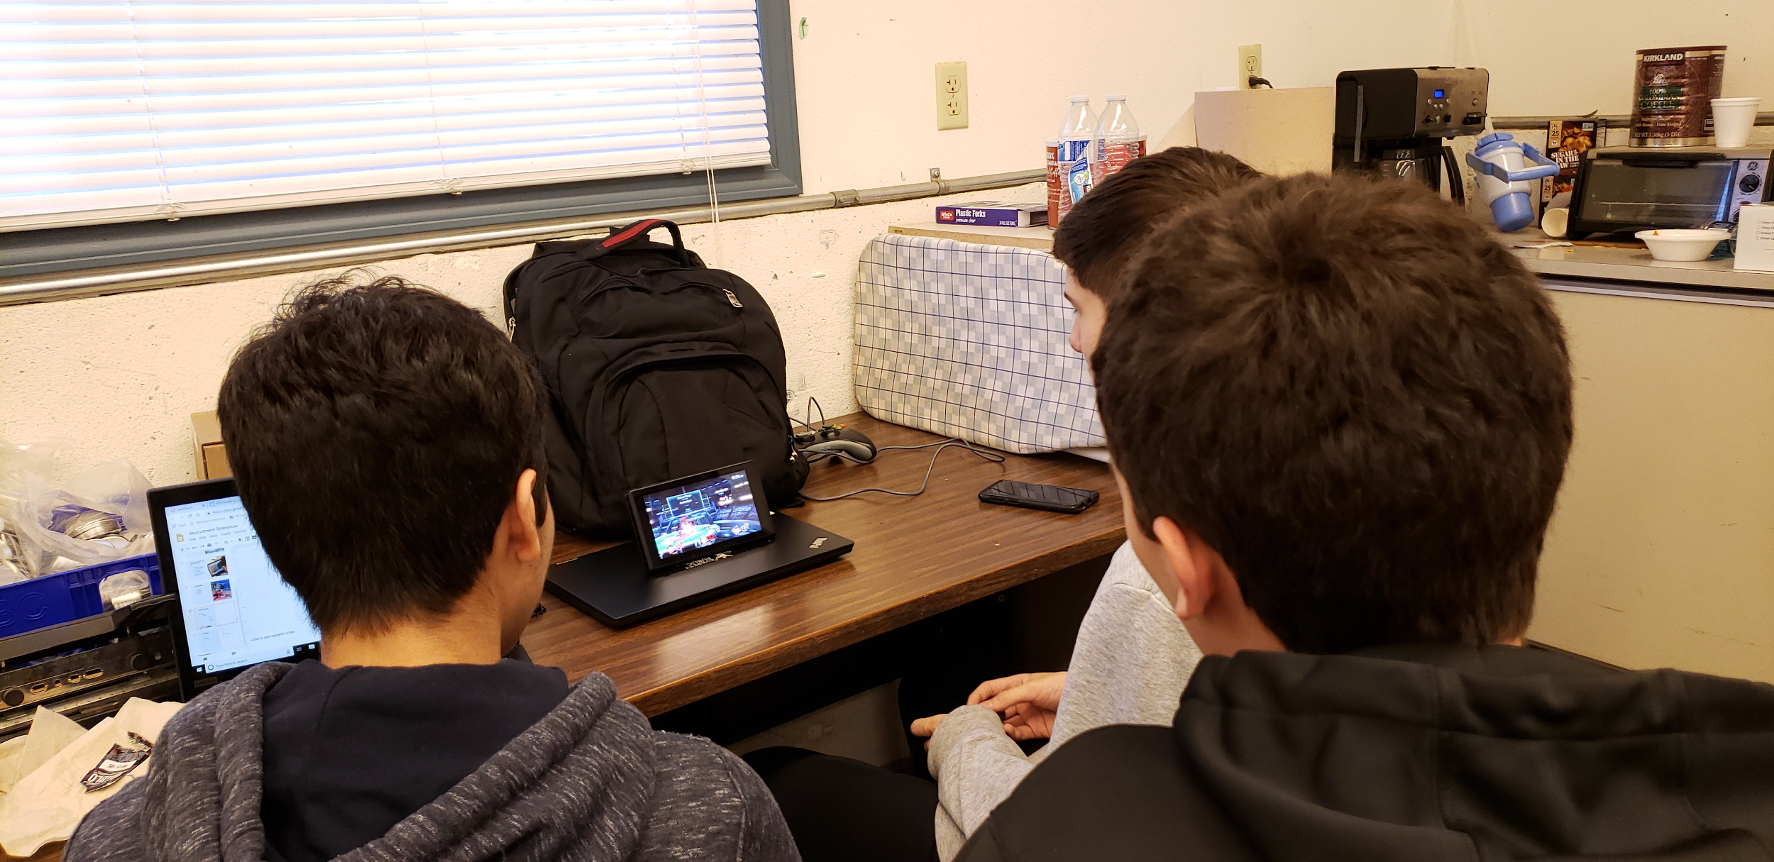
Team Bonding
Games
  Smash Bros
  Uno
  Family Feud
Activities
  Cup Stacking with rubber bands
  Spaghetti and marshmallow challenge
Notes:
Team building is a very important challenge to tackle even before you begin thinking about building robots. This gives students a chance to start developing a problem solving skill set all while getting to have fun and meet their fellow team mates.

Slide 7
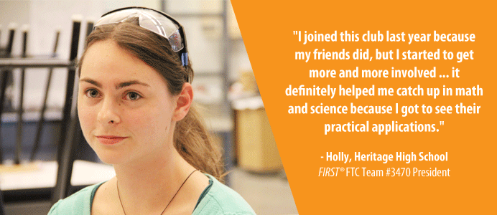

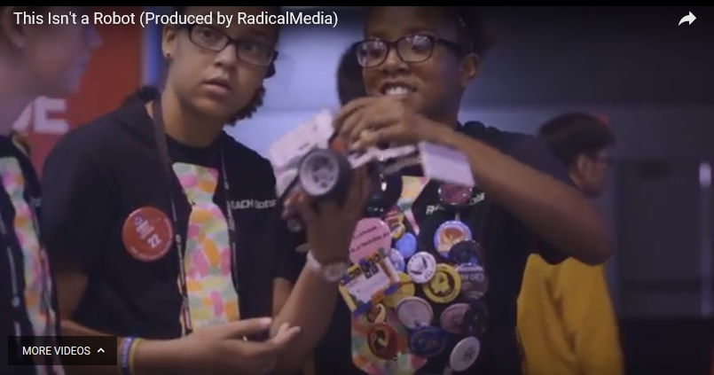
The Impact: How has FIRST changed your life?
In short, it probably saved me at least a year of unnecessary waiting and education, so I can get started on my future faster, and it certainly gave me more confidence in myself, although you never would've known I lacked that.
It gave me the motivation ..
It gave me on-the-job experience ..
It gave me the tools I need to succeed ..
It gave me the future ..
FIRST gave me the best friends I had in high school. It taught me to neglect my wrong first impressions of people and appreciate the best of all.
FIRST gave me confidence in my college education. It showed me that I really do love electronics and programming, and I'm as happy as I can be with my major.
FIRST gave me an opportunity to thrive. It was a great place to be a leader in something, even though my family couldn't afford participation fees in other extra curricular activities. It was a shot of self confidence that was long over due.
Click to start video

Slide 8
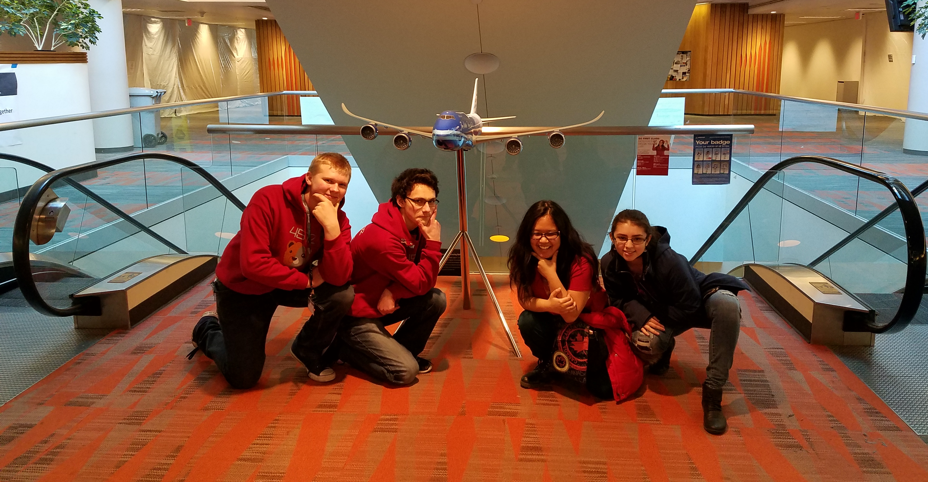
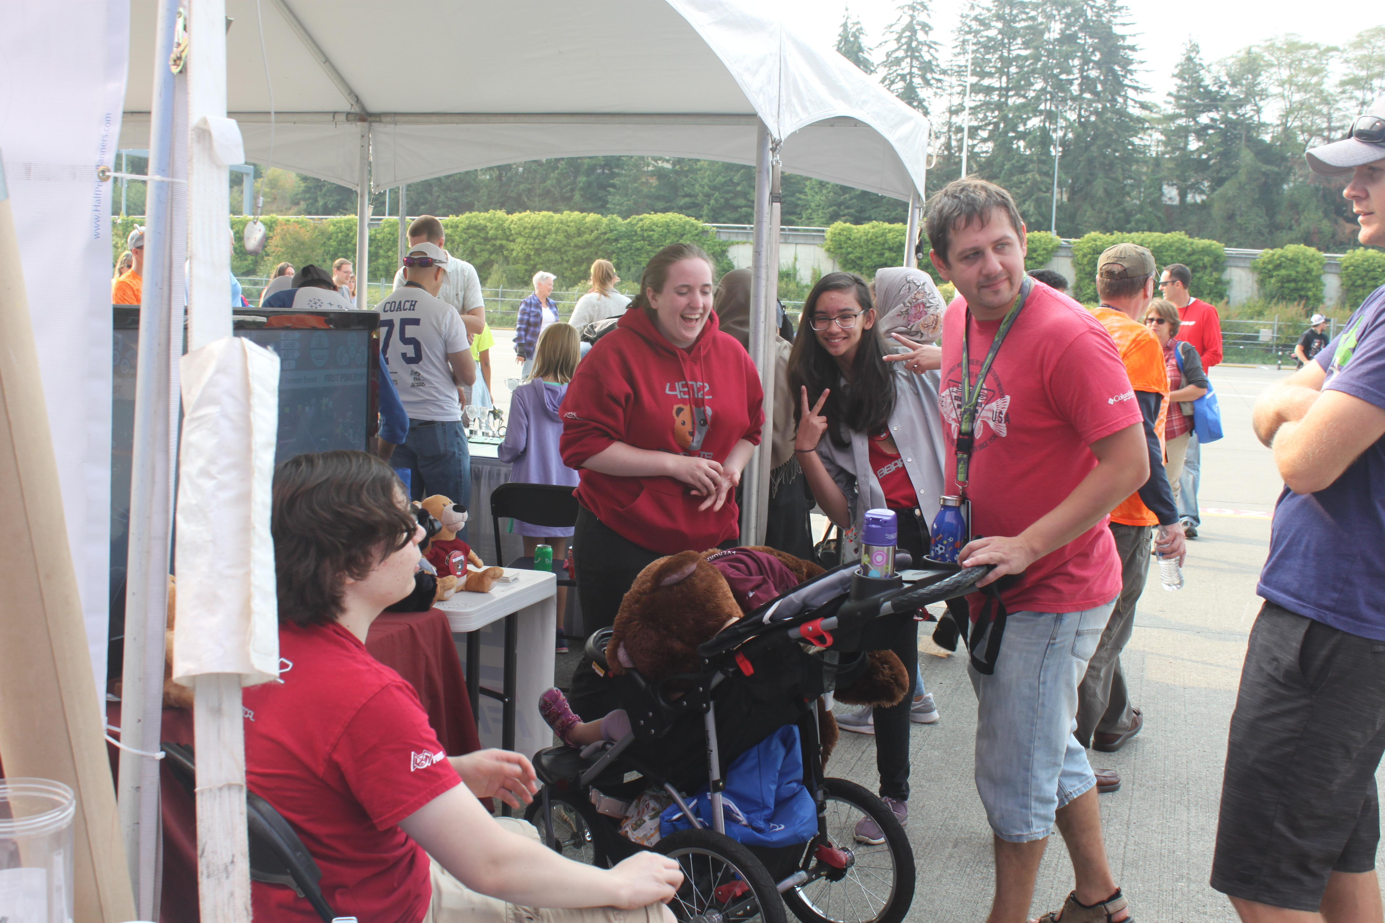
The End
Questions?
Contact:
Coach Neil Palachuk
npalachuk@everettsd.org
425-210-3385
or any of our student team members @ otterchaos4512@gmail.com

